Slide 1
Transit Performance and Reliability Evaluation for Arterial Corridors
Natalia Zuniga Garcia, M.Sc.
Randy B. Machemehl, Ph.D.
Natalia Ruiz-Juri, Ph.D.
Heidi W. Ross, M.Sc.
Nadia Florez-Morcote, M.Sc.
June 5th, 2019

Slide 2
Outline
Background
Introduction
Case Study
Metrics
Future Work
2/14

Slide 3
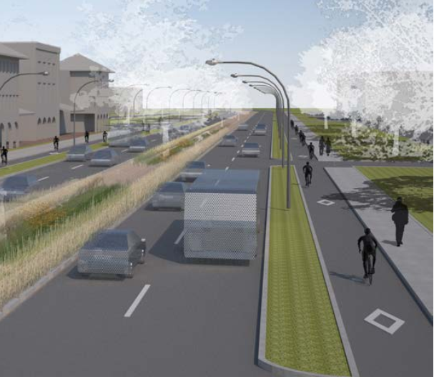
Background
Development, design, and construct improvements along key Austin corridors that enhance mobility, safety, and connectivity for all users.
Recommendations supported by identifiable metrics to prioritize:
reduction in congestion
improved level of service for all modes of travel
connectivity, and improved effectiveness of transit operations
3/14

Slide 4
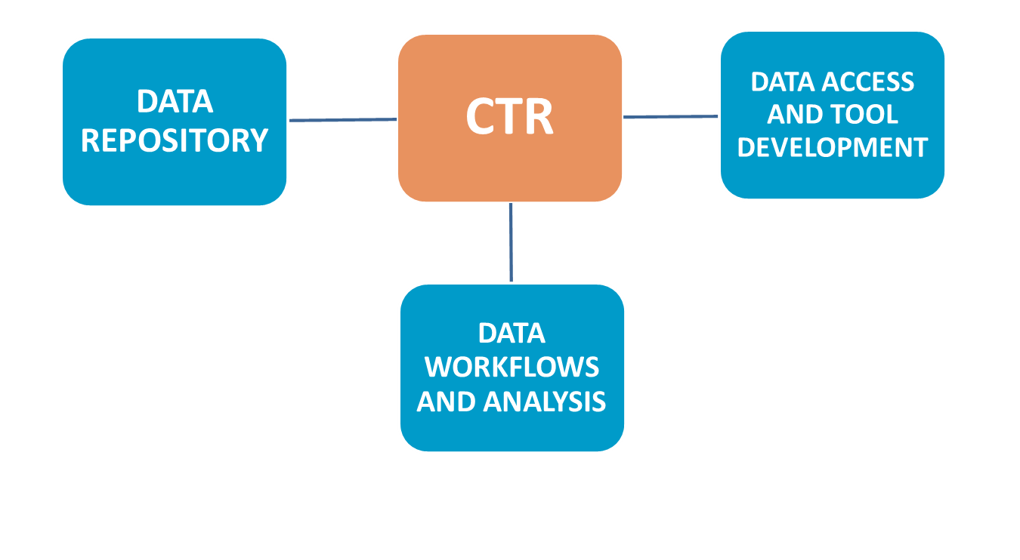
Background
Our Role
Generate performance metrics for bond corridor evaluation by practitioners
Identify current and future data sources
Complete back office system architecture capable of ingesting data from multiple sources
Develop a tool that uses data from multiple sources to calculate key performance metrics
4/14

Slide 5
Introduction
Recent advances in ITS transit data-collection allow evaluation of multiple operational variables.
Problem
Digesting and understanding the large amount of complex data available
For arterial corridors: the presence of different traffic control systems, multiple transit routes, and multimodal interaction
Objective
Develop an evaluation tool to provide transit performance and reliability information for arterial corridors in Austin, Texas.
5/14

Slide 6
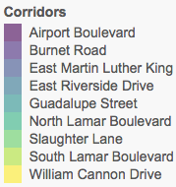
Case Study
6
2
5
1
3
8
9
4
7
1
2
3
4
5
6
7
8
9
6/14

Slide 7
Metrics: Tool Development
Measurable Impacts
Data Sources
GTFS
AVL
APC
Vehicle Capacity
Transit Speed
Ridership
Occupancy
Dwell Time
Delay
Volume-to-Capacity Ratio
Reliability
Service Coverage
Frequency
Automated Analysis
7/14

Slide 8
Metrics: Transit Speed on Corridors
Speed estimated using AVL data
GPS points (location & time stamp) for all buses
Average speed through the corridor
Difference in time stamps over distance
Distance is corridor length covered by bus trajectory
Challenges:
GPS points are provided every 1-2 minutes
The results may not be representative of the entire corridor
Different routes cover different corridor segments
Dwell times are included in travel time
Distance for Bus 3
Bus Route
Corridor
GPS points Bus 1
GPS points Bus 2
GPS points Bus 3
8/14

Slide 9
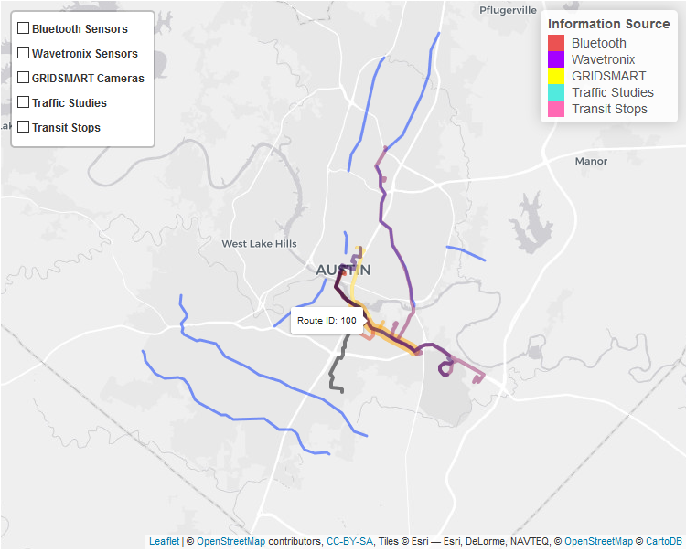
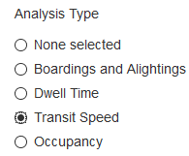
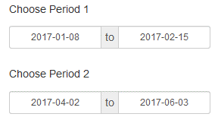
Metrics: Transit Speed on Corridors
1. Choose Analysis Type
2. Select Dates and Corridor
3. Visualize Transit Routes Serving Corridor for Analysis
4. Summarize Transit Speed Estimate by Hour and Direction
9/14

Slide 10
Metrics: Occupancy
1. Choose Analysis Type
2. Select Dates and Corridor
Number of Passengers
3. Visualize Transit Routes Serving Corridor for Analysis
4. Summarize Transit Occupancy by Hour
10/14

Slide 11
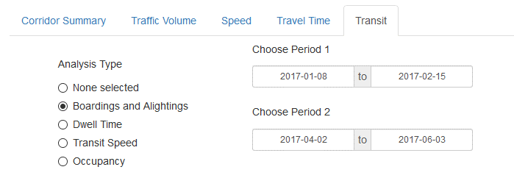
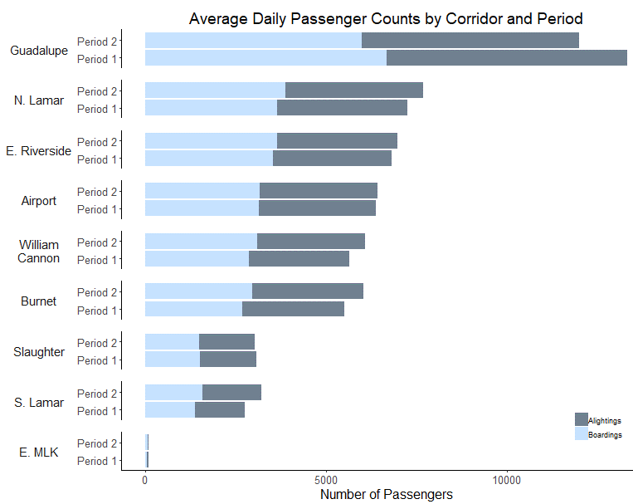
Metrics: Boardings and Alightings
1. Choose Analysis Type
2. Select Dates
3. Visualize Transit Stops and Routes
4. Summarize Passenger Counts
(not normalized by number of stops)
11/14

Slide 12
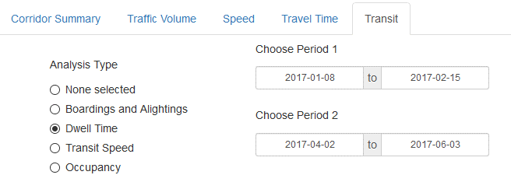
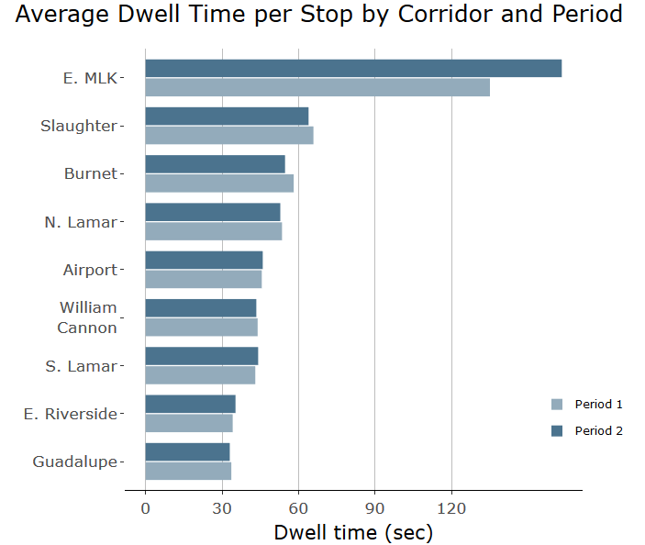
Metrics: Dwell Time
2. Select Dates
1. Choose Analysis Type
3. Visualize Dwell Time and Transit Information
12/14

Slide 13
Future Work
Estimate bus trajectory
Integrate AVL and APC
Update speed estimation
Estimate bus on-time performance
Integrate GTFS and APC
13/14

Slide 14
THANKS
Questions or Comments?
nzuniga@utexas.edu
14/14

